Slide 1
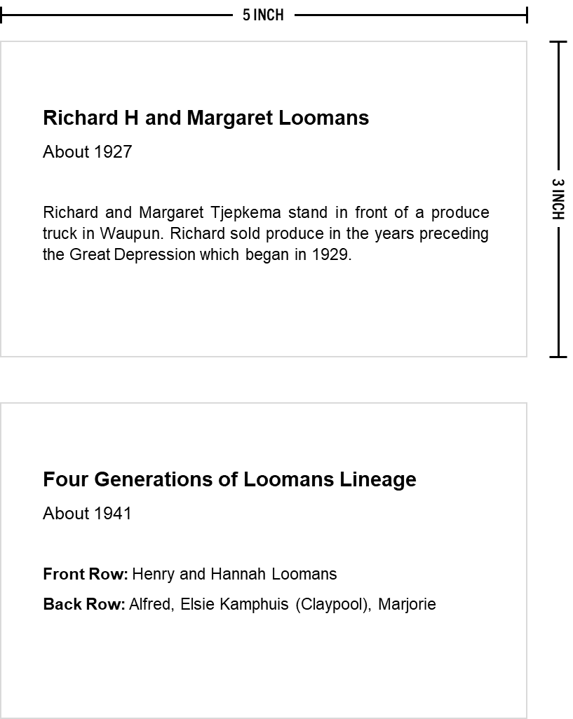
DO NOT PRINT
Photo Board Information Cards
Use to share facts and insight about the photographs on display at your reunion including dates and people shown
What You Need:
Access to a printer or copy machine
Blank sheets of your preferred cardstock color and thickness (65# and 110# are typical options)
Photo Card Examples:
Template Guidance:
Add a title to each photograph—something to describes it in no more than a few words; this could be the name of the person in the image or a name of a gathering
Include the and year if known; you can use words like “About,” “Early,” “Late,” and “Circa” if around a certain year or decade (e.g., Late 1930s, Circa 1950, etc.)
Indicate who is in the photograph and a brief description of the occasion if appropriate
If you need more pages, simply copy and paste a slide
Edit your work and perform spell check
Print the following pages on your preferred cardstock; be sure to select ‘single-sided’ in the print menu
Cut the cards out (paper cutter recommended) on the grey lines which are light enough to be seen but not super noticeable to your guests
© Copyright 2023 Danny Loomans. All rights reserved.
Submit Questions or Feedback at uncommongenealogist.com/templates

Slide 2
[Photo Title]
[Date / Year]
Front Row: [Name], [Name], [Name]
Back Row: [Name], [Name], [Name], [Name]
[Description of the Photo]
[Photo Title]
[Date / Year]
Front Row: [Name], [Name], [Name]
Back Row: [Name], [Name], [Name], [Name]
[Description of the Photo]
[Photo Title]
[Date / Year]
Front Row: [Name], [Name], [Name]
Back Row: [Name], [Name], [Name], [Name]
[Description of the Photo]
[Photo Title]
[Date / Year]
Front Row: [Name], [Name], [Name]
Back Row: [Name], [Name], [Name], [Name]
[Description of the Photo]

Slide 3
[Photo Title]
[Date / Year]
Front Row: [Name], [Name], [Name]
Back Row: [Name], [Name], [Name], [Name]
[Description of the Photo]
[Photo Title]
[Date / Year]
Front Row: [Name], [Name], [Name]
Back Row: [Name], [Name], [Name], [Name]
[Description of the Photo]
[Photo Title]
[Date / Year]
Front Row: [Name], [Name], [Name]
Back Row: [Name], [Name], [Name], [Name]
[Description of the Photo]
[Photo Title]
[Date / Year]
Front Row: [Name], [Name], [Name]
Back Row: [Name], [Name], [Name], [Name]
[Description of the Photo]

Slide 4
[Photo Title]
[Date / Year]
Front Row: [Name], [Name], [Name]
Back Row: [Name], [Name], [Name], [Name]
[Description of the Photo]
[Photo Title]
[Date / Year]
Front Row: [Name], [Name], [Name]
Back Row: [Name], [Name], [Name], [Name]
[Description of the Photo]
[Photo Title]
[Date / Year]
Front Row: [Name], [Name], [Name]
Back Row: [Name], [Name], [Name], [Name]
[Description of the Photo]
[Photo Title]
[Date / Year]
Front Row: [Name], [Name], [Name]
Back Row: [Name], [Name], [Name], [Name]
[Description of the Photo]

Slide 5
[Photo Title]
[Date / Year]
Front Row: [Name], [Name], [Name]
Back Row: [Name], [Name], [Name], [Name]
[Description of the Photo]
[Photo Title]
[Date / Year]
Front Row: [Name], [Name], [Name]
Back Row: [Name], [Name], [Name], [Name]
[Description of the Photo]
[Photo Title]
[Date / Year]
Front Row: [Name], [Name], [Name]
Back Row: [Name], [Name], [Name], [Name]
[Description of the Photo]
[Photo Title]
[Date / Year]
Front Row: [Name], [Name], [Name]
Back Row: [Name], [Name], [Name], [Name]
[Description of the Photo]

Slide 6
[Photo Title]
[Date / Year]
Front Row: [Name], [Name], [Name]
Back Row: [Name], [Name], [Name], [Name]
[Description of the Photo]
[Photo Title]
[Date / Year]
Front Row: [Name], [Name], [Name]
Back Row: [Name], [Name], [Name], [Name]
[Description of the Photo]
[Photo Title]
[Date / Year]
Front Row: [Name], [Name], [Name]
Back Row: [Name], [Name], [Name], [Name]
[Description of the Photo]
[Photo Title]
[Date / Year]
Front Row: [Name], [Name], [Name]
Back Row: [Name], [Name], [Name], [Name]
[Description of the Photo]

