Slide 1
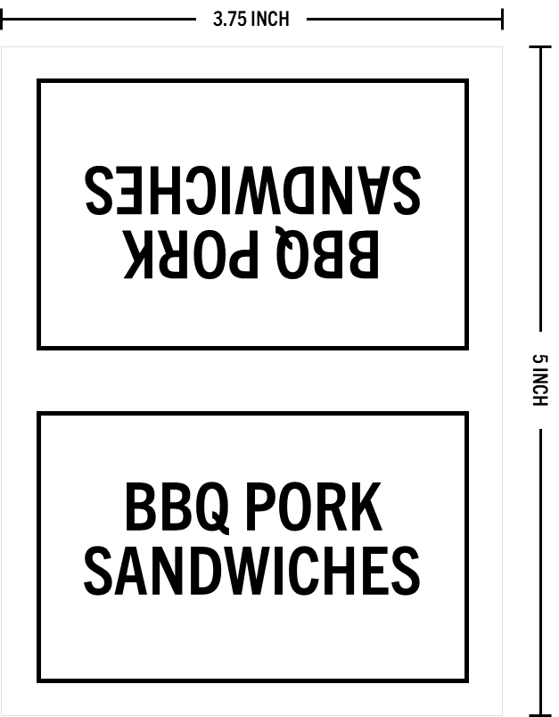
DO NOT PRINT
Food and Refreshment Tent Cards
Use to let guests know what you’re serving on the food and refreshments table
What You Need:
Completed family reunion menu
Access to a printer or copy machine
Blank sheets of your preferred cardstock color and thickness (65# and 110# are typical options)
Tent Card Example:
Template Guidance:
Add the names of your menu items – the names will go in place of the black text on the following pages
Update both sides of the tent card
If you need more pages, simply copy and paste a slide
Perform spell check
Print the following pages on your preferred cardstock; be sure to select ‘single-sided’ in the print menu
Cut the cards out (paper cutter recommended) on the grey lines which are light enough to be seen but not super noticeable to your guests
Fold the cards halfway so that it can sit as a tent
© Copyright 2023 Danny Loomans. All rights reserved.
Submit Questions or Feedback at uncommongenealogist.com/templates

Slide 2
DISH NAME
DISH NAME
DISH NAME
DISH NAME
DISH NAME
DISH NAME
DISH NAME
DISH NAME

Slide 3
DISH NAME
DISH NAME
DISH NAME
DISH NAME
DISH NAME
DISH NAME
DISH NAME
DISH NAME

Slide 4
DISH NAME
DISH NAME
DISH NAME
DISH NAME
DISH NAME
DISH NAME
DISH NAME
DISH NAME

