Slide 1
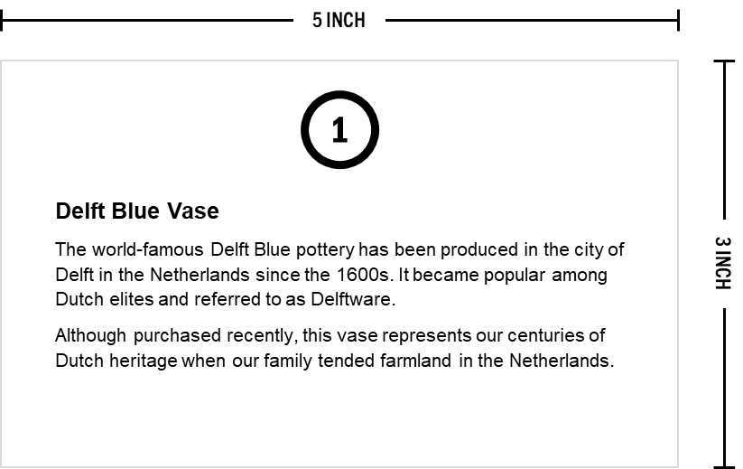
DO NOT PRINT
Explore Our Story Exhibit Cards
Use to share facts and information about the various artifacts displayed in your ‘Explore Our Story’ exhibit
What You Need:
Completed “Explore Our Story” Storyboard (download the template at uncommongenealogist.com/templates)
Access to a printer or copy machine
Blank sheets of your preferred cardstock color and thickness (65# and 110# are typical options)
Exhibit Card Example:
Template Guidance:
Complete the “Explore Our Story” Storyboard activity to identify the different exhibits in your setup
Add an exhibit name (make it short and clear) and a description of the exhibit item on each of the following pages of the template as necessary
If you need more pages, simply copy and paste a slide
Edit your work and perform spell check
Print the following pages on your preferred cardstock; be sure to select ‘single-sided’ in the print menu
Cut the cards out (paper cutter recommended) on the grey lines which are light enough to be seen but not super noticeable to your guests
© Copyright 2023 Danny Loomans. All rights reserved.
Submit Questions or Feedback at uncommongenealogist.com/templates

Slide 2
[Exhibit Name]
[Exhibit Description]
[Exhibit Name]
[Exhibit Description]
1
2
[Exhibit Name]
[Exhibit Description]
[Exhibit Name]
[Exhibit Description]
3
4

Slide 3
[Exhibit Name]
[Exhibit Description]
[Exhibit Name]
[Exhibit Description]
5
6
[Exhibit Name]
[Exhibit Description]
[Exhibit Name]
[Exhibit Description]
7
8

Slide 4
[Exhibit Name]
[Exhibit Description]
[Exhibit Name]
[Exhibit Description]
9
10
[Exhibit Name]
[Exhibit Description]
[Exhibit Name]
[Exhibit Description]
11
12

Slide 5
[Exhibit Name]
[Exhibit Description]
[Exhibit Name]
[Exhibit Description]
13
14
[Exhibit Name]
[Exhibit Description]
[Exhibit Name]
[Exhibit Description]
15
16

Slide 6
[Exhibit Name]
[Exhibit Description]
[Exhibit Name]
[Exhibit Description]
17
18
[Exhibit Name]
[Exhibit Description]
[Exhibit Name]
[Exhibit Description]
19
20

